Slide 1


BUREAU
of Real Estate
forum
Marriott Hotel - Anaheim, CA
January 28, 2016

Slide 2
Today’s Agenda
  Opening Remarks – Commissioner Wayne Bell
    Operations Report –
    Jeffrey Mason, Chief Deputy Commissioner
    Enforcement Update-
    Rick Fong, Assistant Commissioner, Enforcement
    Legal and Consumer Recovery Account–
    Stephen Lerner, Assistant Commissioner Legal Affairs
    Audit Report and Update–
    Dan Sandri, Assistant Commissioner, Audits
    Q & A and Dialog
    Wayne Bell and Panel

Slide 3
BUREAU
of Real Estate
Operations Report
Jeffrey Mason
Chief Deputy Commissioner

Slide 4
Financial Statistics
FY 2015-2016
$51.7 MILLION BUDGET
FIVE OFFICES/EXAM CENTERS
SACRAMENTO | OAKLAND | FRESNO | LOS ANGELES | SAN DIEGO
 | 7/1/2014 – 06/30/15
Budget | $50,264,000
Revenues | $50,033,941

Slide 5
License Population
License Population Peak 11/2007:
549, 250
License Population as of 1/25/2016:
405,046

Slide 6
MORTGAGE LENDING ACTIVITY
Need MLO Endorsement to Originate Residential Loans
MLO Stats
 | Jan. 2015 | Jan. 2016
Approved Individuals | 15,668 | 16,631
Approved Companies | 4,595 | 5,424
Approved Branches | 854 | 897
Total MLOs | 21,117 | 21,952

Slide 7
SUBDIVISIONS WORKLOAD
Applications for Public Report
 | 1/1/2014-12/31/2014 | 1/1/2015-12/31/2015
Final | 2671 | 2818
Renewal | 417 | 274
Amendment | 215 | 256
Total Applications Received | 3303 | 3348
TOTAL UNITS CREATED
2014: 29,804
2015: 32,298

Slide 8
ENFORCEMENT DISCIPLINARY
ACTIONS
 | 1/1/2015-12/31/2015
License Denials | 96
Disciplinary Actions (Revocations, Surrenders, Suspensions, Public Reprovals) | 743
Desist & Refrain Orders | 49
Citations | 723

Slide 9
Audit Closings
 | 1/1/2014-12/31/2014 | 1/1/2015-12/31/2015 | % Change
Investigative Audit Closings | 342 | 324 | -5.3%
Routine Audit Closings | 283 | 283 | 0%
Shortage Findings | $6,483,781 | $13,873,222 | 114%

Slide 10
LICENSING WORKLOAD
 | 1/1/2014-12/31/2014 | 1/1/2015-12/31/2015 | % Change
Exams Scheduled
RES | 46,917 | 46,522 | -1%
REB | 7,074 | 5,362 | -24%
New Licenses
RES | 20,210 | 20,843 | 3%
REB | 5,072 | 4,367 | -14%
Renewals
RES | 52,684 | 50,323 | -4%
REB | 30,190 | 28,241 | -6%
Renewal Rate
RES | 73% | 79% | 9%
REB | 83% | 88% | 6%
Total Licensees
RES | 265,414 | 269,458 | 2%
REB | 137,344 | 135,499 | -1%

Slide 11
Licensing
Processing Times
Phone Wait Times

Slide 12
By the Numbers
Average Exam Wait Times:
  Applicant Self Schedules:
    No wait times
    Sales exam candidates can schedule into an exam up to 6:00 am the day of the exam provided there is space available at the exam site.
    Broker examinations are administered once a week, depending on location.
  Applicant does not self schedule: they will be given the next available date, which will be at least two weeks out so that a schedule notice can be mailed to them.

Slide 13
By the Numbers
Average Application Processing Times
  Salesperson Exam: 6 Weeks
  Broker Exam: 4 weeks

Slide 14
By the Numbers
Average Number of Calls per Month
  21,130
  8 Staff Dedicated to Phones
  Many Calls Involve Status of Applications

Slide 15
Renewals
17,226 Renewals by Mail
  Currently 4 Week Backlog

Slide 16

Secret Door

Slide 17

http://www.dre.ca.gov/

Slide 18
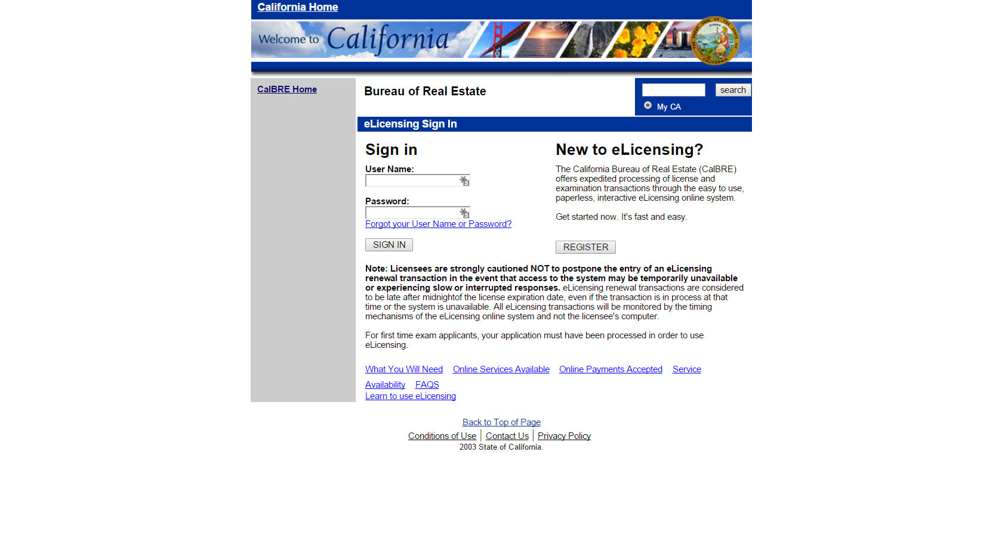

Slide 19
eLicensing
Broker renewals (instant)
Salesperson renewals (instant)
Salesperson terminations
Update contact information (email and phone numbers)
Salesperson changes of employing broker
Broker main office address changes
Mailing address changes
Print license certificate

Slide 20
Other Timesaving Licensing Resources
Combo Applications
  38,781 REB Exam Applications
    5,297 Did Not Use Combo Application
  91,596 RES Exam Applications
    26,764 Did Not Use Combo Application
Website Resources
  New Videos on RES/REB exam/app process
  Posting of Current Processing Times
  Posting of FAQs

Slide 21
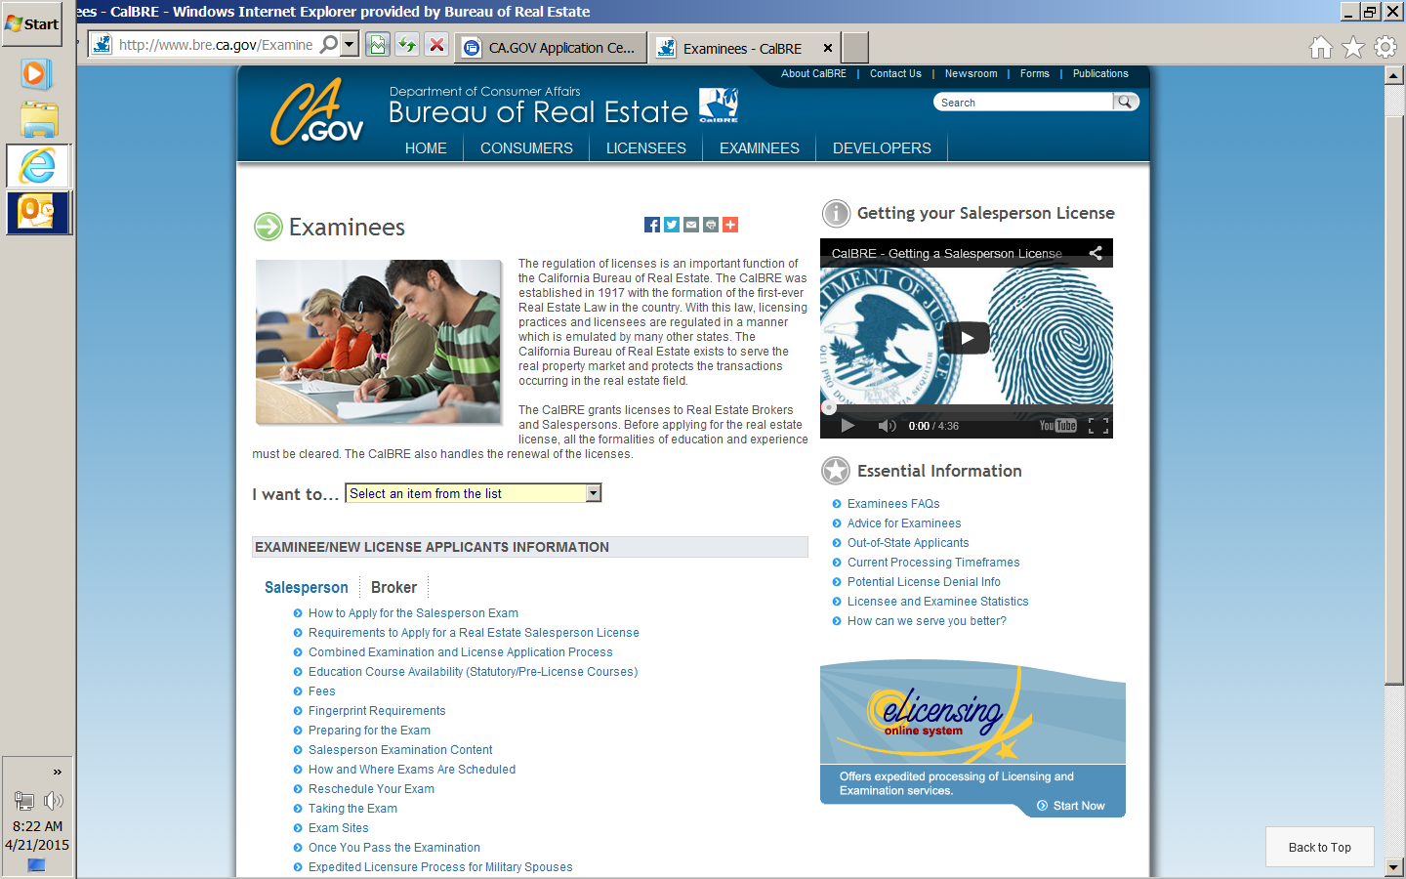
Website Resources

Slide 22
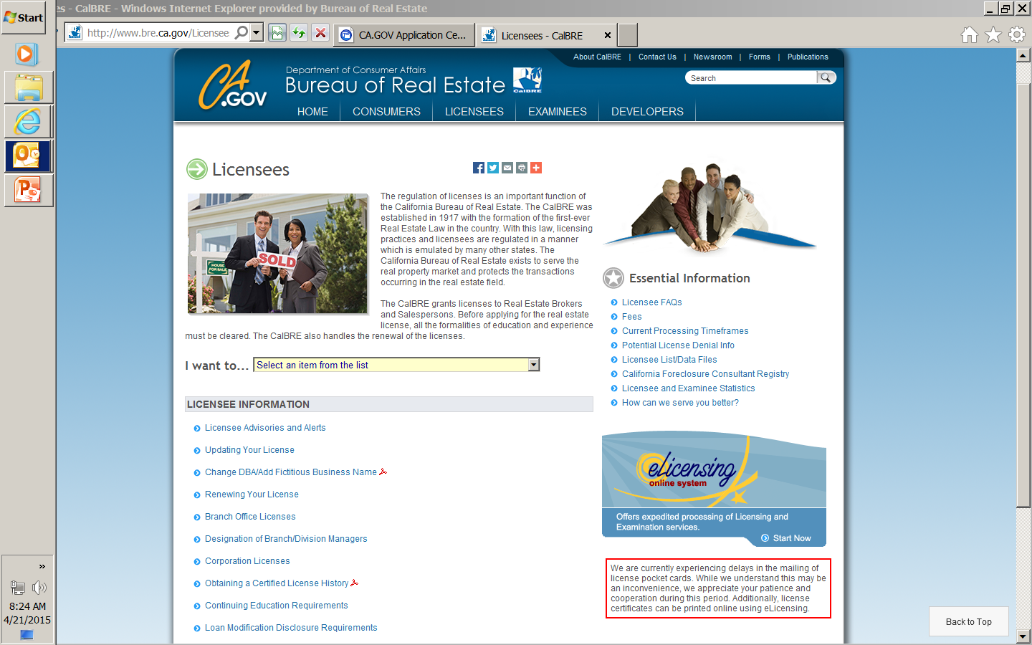
Website Resources

Slide 23
Enforcement
Update
Rick Fong
Assistant Commissioner
Enforcement

Slide 24
Current Enforcement Cases/Investigations
  1955 Cases

Slide 25
Most Common Enforcement Cases
  Foreclosure Rescue
  Advertising Compliance
  Fraud
Notes:
These include active, inactive, and CRP cases. Thus, these will differ from the stats for active investigations in your report because of those inactive and CRP cases included here but not in the report’s stats.

Slide 26
Most Common Enforcement Cases
  Trust Fund Records
  Negligence
  Licensing Compliance

Slide 27
Most Common Enforcement Cases
  Misrepresentation/Dishonest Dealing
  Unlicensed Activity
    Property Management
    Sales Agent acting as Brokers
    Acting as Real Estate Agent

Slide 28
Cite & Fine
 | Citations Issued | Fines Assessed | Fines Collected
2013 | 57 | $108,000 | $108,000
2014 | 195 | $317,125 | $311,125
2015 | 723 | $272,700 | $195,850
Total | 975 | $697,825 | $614,975

Slide 29
Most Common Cite & Fine Cases
  Negligence
  Lacking or inadequate supervision
  Failure to maintain proper record
  No monthly reconciliation

Slide 30
Complaint Resolution Program (CRP)
Number of Active CRP Cases:
  77 cases
Total Settlements (past five months)
  $100,000

Slide 31
Most Common Complaint Resolution Program Cases
  Landlord Tennant disputes involving a licensed property management dispute
  Listing Agreement Dispute
  Refund of Fees spent in an unsuccessful transaction
  Earnest Money Dispute

Slide 32
CALIFORNIA BUREAU
OF REAL ESTATE’S
Legal and Consumer Recovery account
Stephen Lerner
Assistant Commissioner
Legal Affairs

Slide 33
California Bureau of Real Estate – Legal Affairs
Disposition of Cases
Category | 2015
Desist & Refrain Orders | 48
License Suspensions | 123
License Surrenders | 91
License Revocations | 430
Case Dismissals | 87
Public Reprovals | 17
Stipulation & Waiver/Agreement | 281
Application Denials | 95
License Denials and Restrictions | 66
Total | 1,238

Slide 34
California Bureau of Real Estate – Legal Affairs
5 Most Frequent Violations - 2015
Improper Record Keeping (Failure to reconcile; Failure to maintain accurate records; Incomplete transaction files).
Unlicensed Activities (Sales agents conducting broker activities without broker’s license; Property management without broker’s license or supervising broker).
Foreclosure Rescue/Advance Fees.
Fraud/Conversion/Misrepresentation (Straw-purchasers; Forging loan documents).
Broker Controlled Escrows (Commingle; Failure to deposit trust funds in trust accounts; Failure to identify trust accounts; Allowing non-licensees as signatories on trust accounts).

Slide 35

CALIFORNIA BUREAU OF REAL ESTATE’S CONSUMER RECOVERY ACCOUNT

Slide 36
PURPOSE
Last resort victim’s fund to compensate innocent members of the public who are victimized by dishonest real estate licensees

Slide 37
HISTORICAL BACKGROUND
Operative on January 1, 1964
12% of License Fees
(B&P Code §10450.6)
$3,500,000/year

Slide 38
CONSUMER RECOVERY ACCOUNT
Claims History
Since 1964, BRE has paid over
$52 million to victims
Approximately 54% of all applications paid

Slide 39

CLAIM
REQUIREMENTS

Slide 40

WHO MAY FILE
“Aggrieved Person”
CONSUMER
INNOCENT MEMBER OF THE PUBLIC

Slide 41
BASIS FOR APPLICATION
1) Final Judgment
2) Licensed Activity
3) Actual and Direct Loss

Slide 42
COVERAGE LIMITS
(B&P Code § 10474.5)
as of 2008
$50,000/per transaction
$250,000/per licensee

Slide 43
California Bureau of Real Estate – Legal Affairs
Consumer Recovery Account
(2015)
Category |  | Total
Claims Filed |  | 72
Disposition of Claims | Paid | 106
 | Denied | 86
Amount Paid |  | $3,922,533
Average Paid Per Claim |  | $37,716

Slide 44
California Bureau of Real Estate – Legal Affairs
Consumer Recovery Account
(2015)
Category | REB | Corporation | Officer | RES | Total
License Suspensions | 20 | 7 | 8 | 39 | 74

Slide 45

CONSUMER RECOVERY ACCOUNT
Questions
(916) 263-8925

Slide 46


Bureau of Real Estate Audits
Dan Sandri
Chief Auditor

Slide 47
Audits Closed by Activities Statewide – 7/1/15 - 12/31/15

Slide 48
Findings of Audits Closed,
7/1/15 – 12/31/15

Slide 49
Shortage Findings of Audits Closed
 | 7/1 – 12/31 2014 | 7/1 – 12/31 2015
Total Audits Closed | 286 | 281
Total $ Shortage | $2.87 million | $9.84 million
% Audits with Shortage | 34.3% | 38.1%
#(%) with $10K+ Shortage | 31 (10.8) | 36 (12.8)

Slide 50
Causes of Shortage,
7/1/15 - 12/31/15
$9,838,321 found, with causes as follows:
$5,175,754 – negative beneficiary balances
$1,303,498 – commingling/conversion
$675,837 – embezzlement
$141,372 – bank charges and fees
$2,537,218 – unidentified causes

Slide 51

What Audits is Seeing
We continue to find:
Trust fund shortages in property management and broker escrow activities.
Many problems with property management and broker escrow operations run by RES or unlicensed owners, without sufficient supervision
Delays in providing records
Falsification of bank records

Slide 52
Where Audit Activities Are Focused
Investigative and Focused Routine audits on those who handle a high volume of trust funds
Property Management, Broker Escrow and hard money MLB
Unsupervised operations involved in these activities
Restricted Licensees handling trust funds

Slide 53

Bureau of Real Estate
Audit Section
Contact:
Dan Sandri – Assistant Commissioner, Audits
Dan.Sandri@dre.ca.gov
916 263-8704

Slide 54
Q&A
THANK YOU
This power point presentation will be made available in its entirety on the CalBRE website.
www.bre.ca.gov
Next Meeting to be held in
Sacramento, CA – May 2016

